Slide 1
Portable Ultrasound Device (PUD) for Coda-Wave Interferometry
Spring ‘24
Sprint 2
Prepared by Michael Kisellus, Christopher Coppedge,
Leyton Foxworthy, Matthew Baker, Kyle Fox
Product owner : Dr. Brown
06 MAR 2024

Slide 2
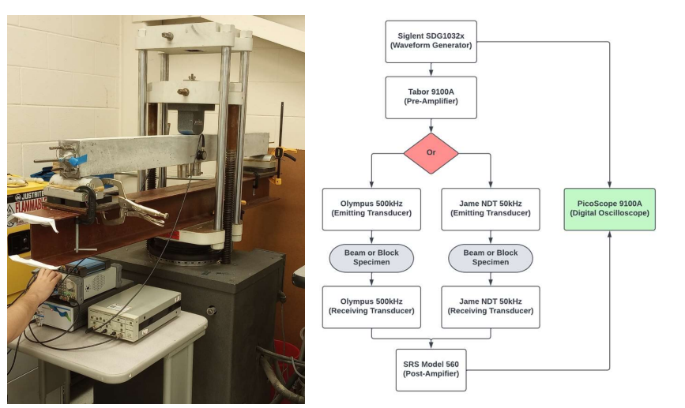
Introduction - Background
Civil engineering lab has a concrete “scanning” process that involves measuring how ultrasonic waves travel through the concrete

Slide 3
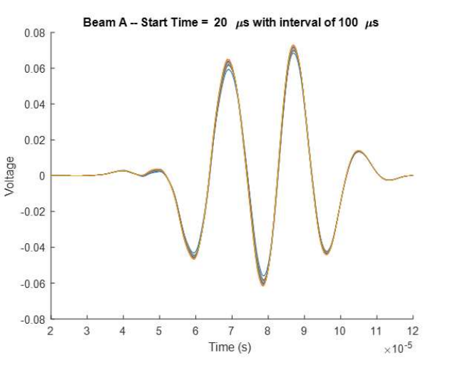
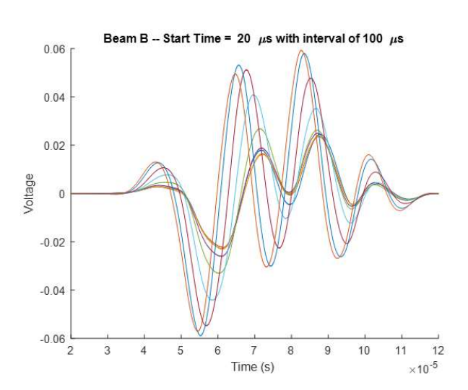
Introduction - Background
Data analysis, can reveal imperfections in the concrete.
Scan of an undamaged section of concrete
Scan of a compromised section of concrete

Slide 4
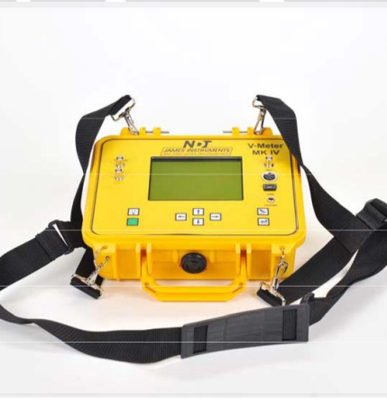
Introduction - Purpose
Produce a handheld ultrasound inspection device for inspecting a bridge/structural component for faults in the field.
Inspection Unit gathers and stores test data collected over time (48 to 72 hours).
Budget - $2000
Rationale:
Existing commercial solution is expense (~ 5000 USD)
Existing solution cannot operate without operator present.

Slide 5
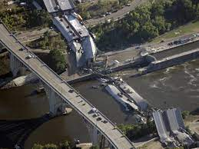
Introduction
Benefit to society:
More thorough inspections for concrete pillar support systems.
This increases safety for publicly used infrastructure such as bridges.

Slide 6
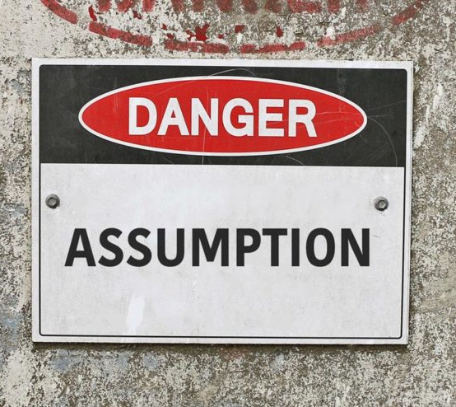
Design Considerations - Assumptions
Ambient temperatures during operation shall not exceed 100° F.
The battery is fully charged before sampling starts.
The battery is in good condition and has not degraded from age.
The unit is placed in a dry location protected from major weather interference.
The unit is used following the user manual.
The user places the transistor transmitter and receiver correctly.
The unit has no component failures.

Slide 7
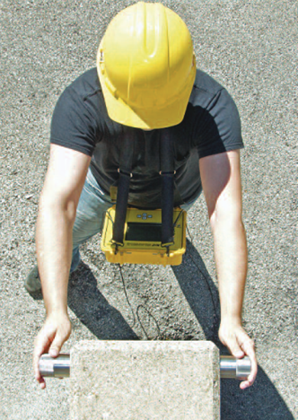
Design Considerations – Requirements and Constraints
The Portable Ultrasound Device (PUD) shall:
Be portable and usable by a single operator.
Initiate testing and record the resulting data.
Operate for 48 to 72 hours without exterior inputs.
Operate in outdoor/ field environment

Slide 8
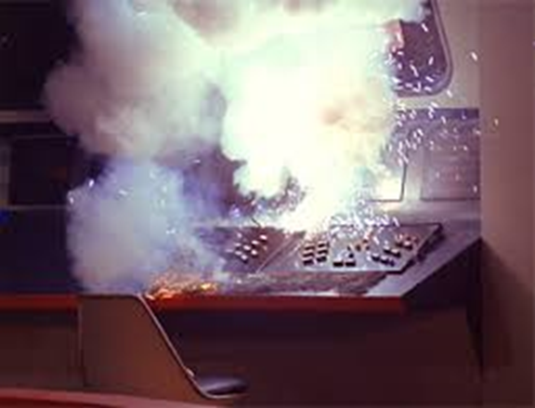
Design Considerations - Risks
Electrical shock (500v)
Electrical component failure
No industrial standards Requested by client or instructors

Slide 9
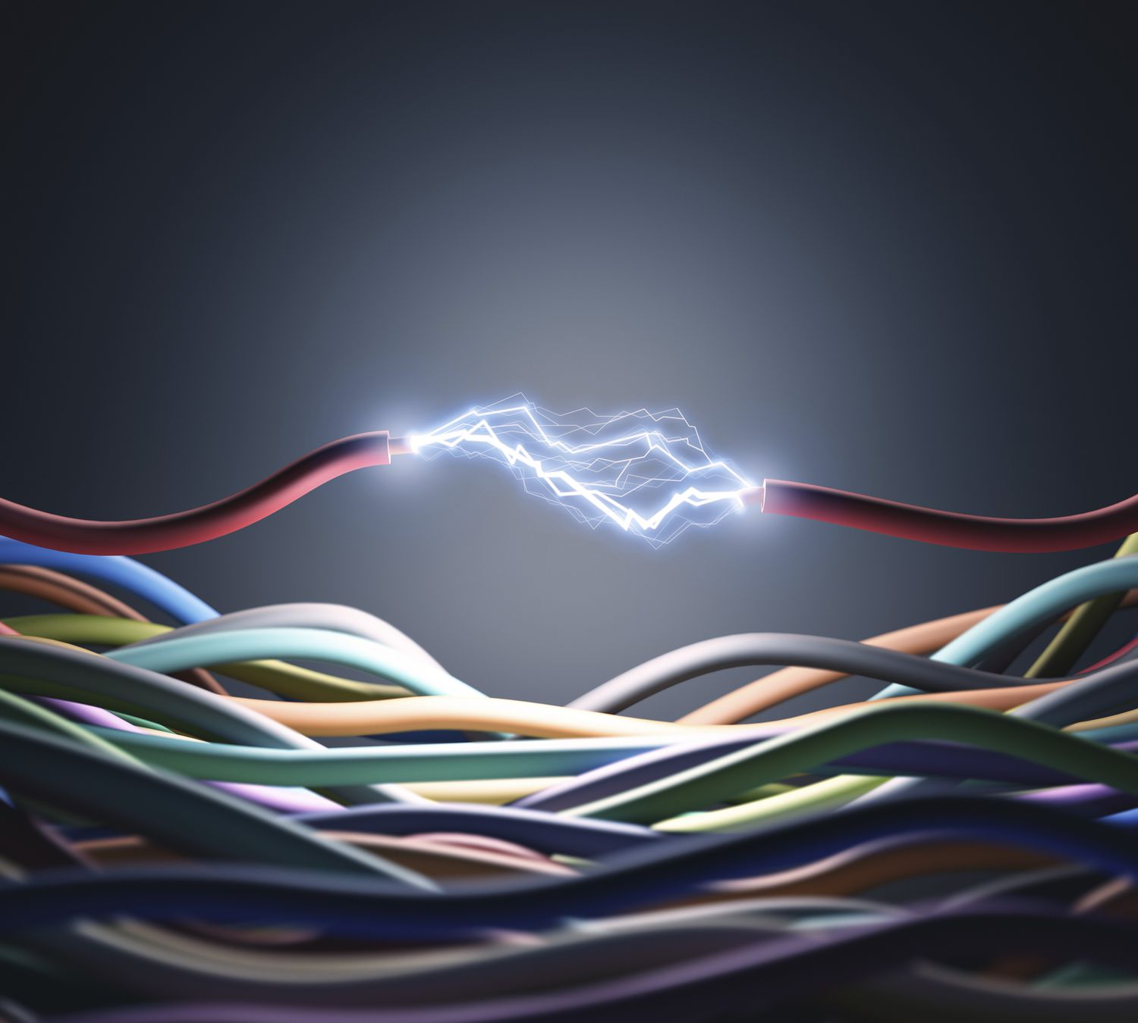
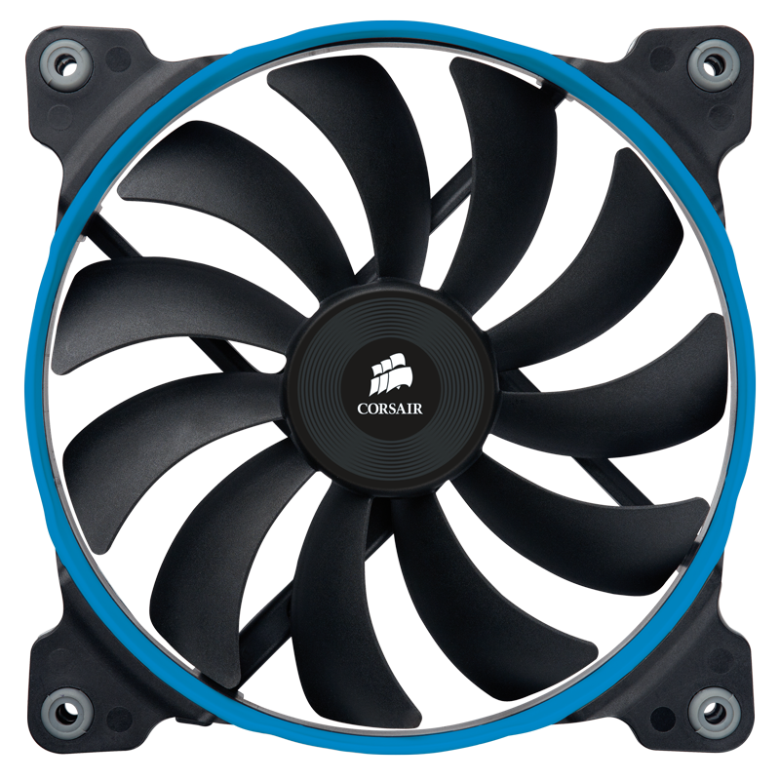

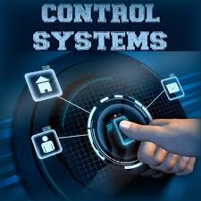
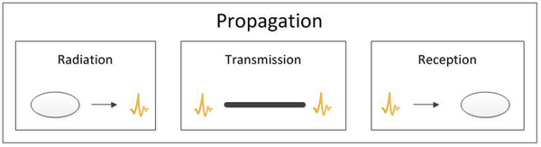
System Architecture – Major Subsystems
Hardware
Electrical system
Enclosure and Mounting system
Cooling system
Software
Transmit (Tx) and Receiver (Rx) system
Control system

Slide 10
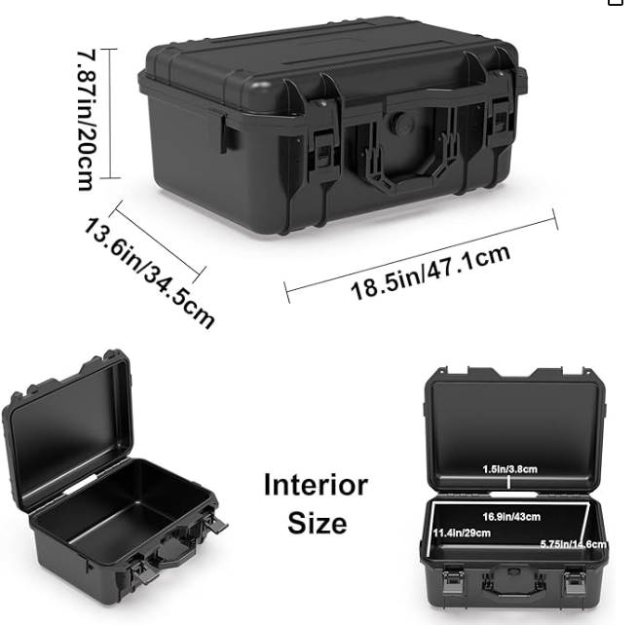
System Architecture – Enclosure And Mounting System
Enclosure
Off the shelf case
Mounting
Velcro, silicone putty, and screws.

Slide 11
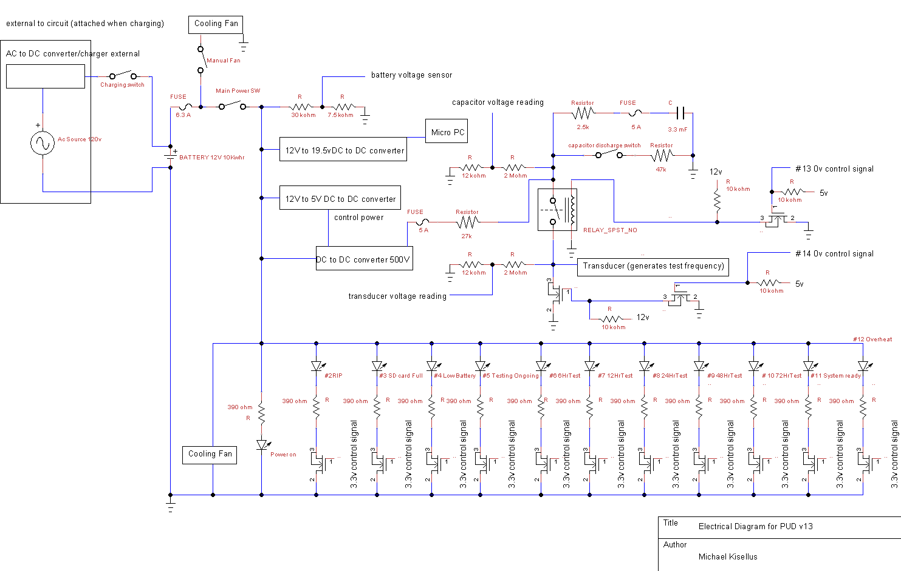
System Architecture – Electrical System
System provides:
5v
12v
19.5v
500v
Ability to sense voltages at test points
Battery recharging without removal

Slide 12
Sub-System Design–
Electrical System Low voltage

Slide 13
Sub-System Design–
Electrical System High voltage

Slide 14
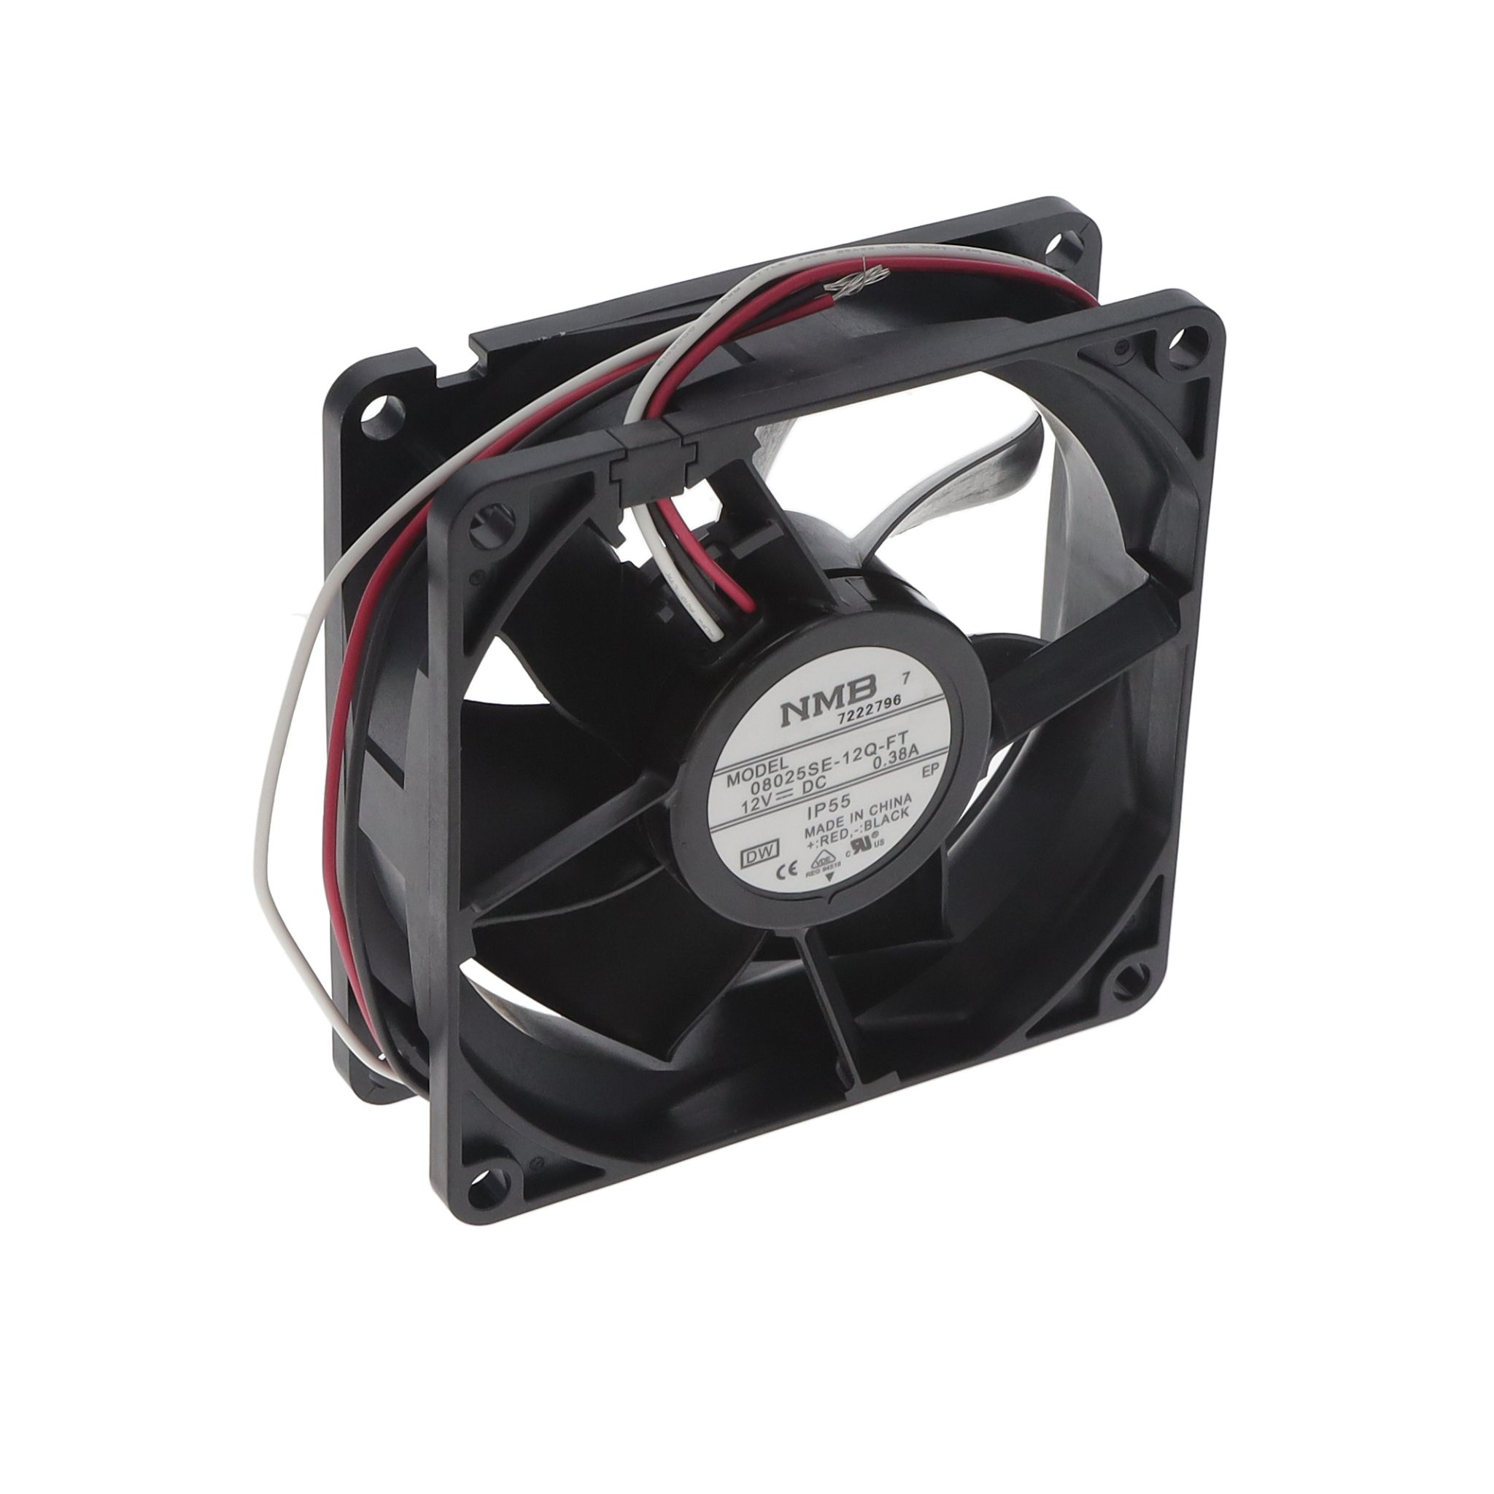
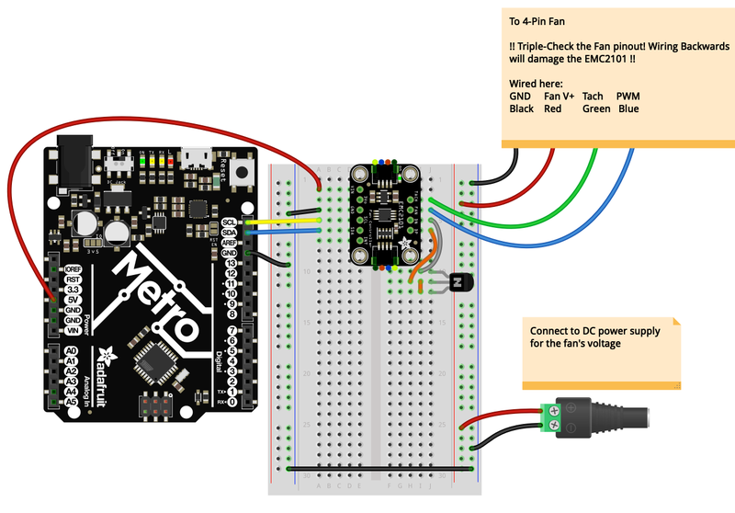
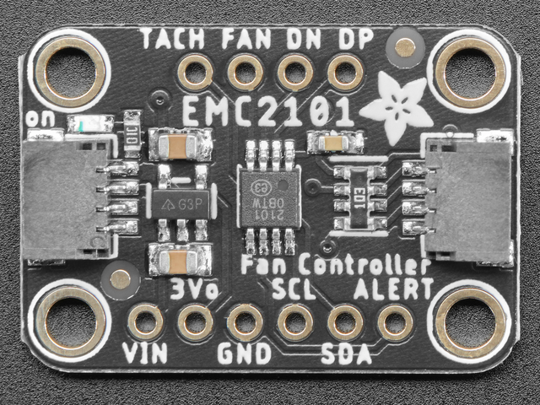
System Architecture – Cooling System
NMB Corp 12VDC, IP55 rated fan
w/EMC2101 Fan Controller
Wiring example for EMC2101

Slide 15
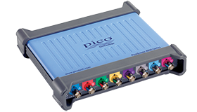
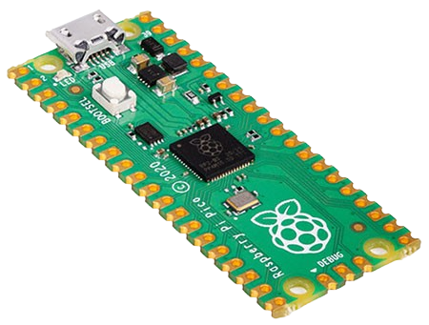
System Architecture –
Tx, Rx, And Control System
Current RX/TX System Status:
RX side is assembled with an oscilloscope connected to a minicomputer to record and process data
TX side is a custom electrical circuit that uses a HV capacitor and MOSFET to pulse the transducer
Control System is a RP2040 that starts the system, times pulses, and

Slide 16
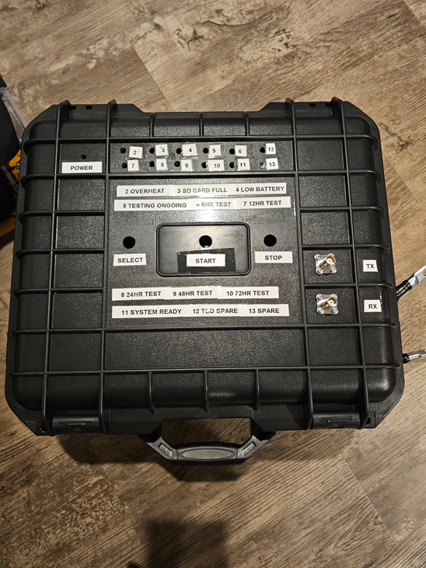
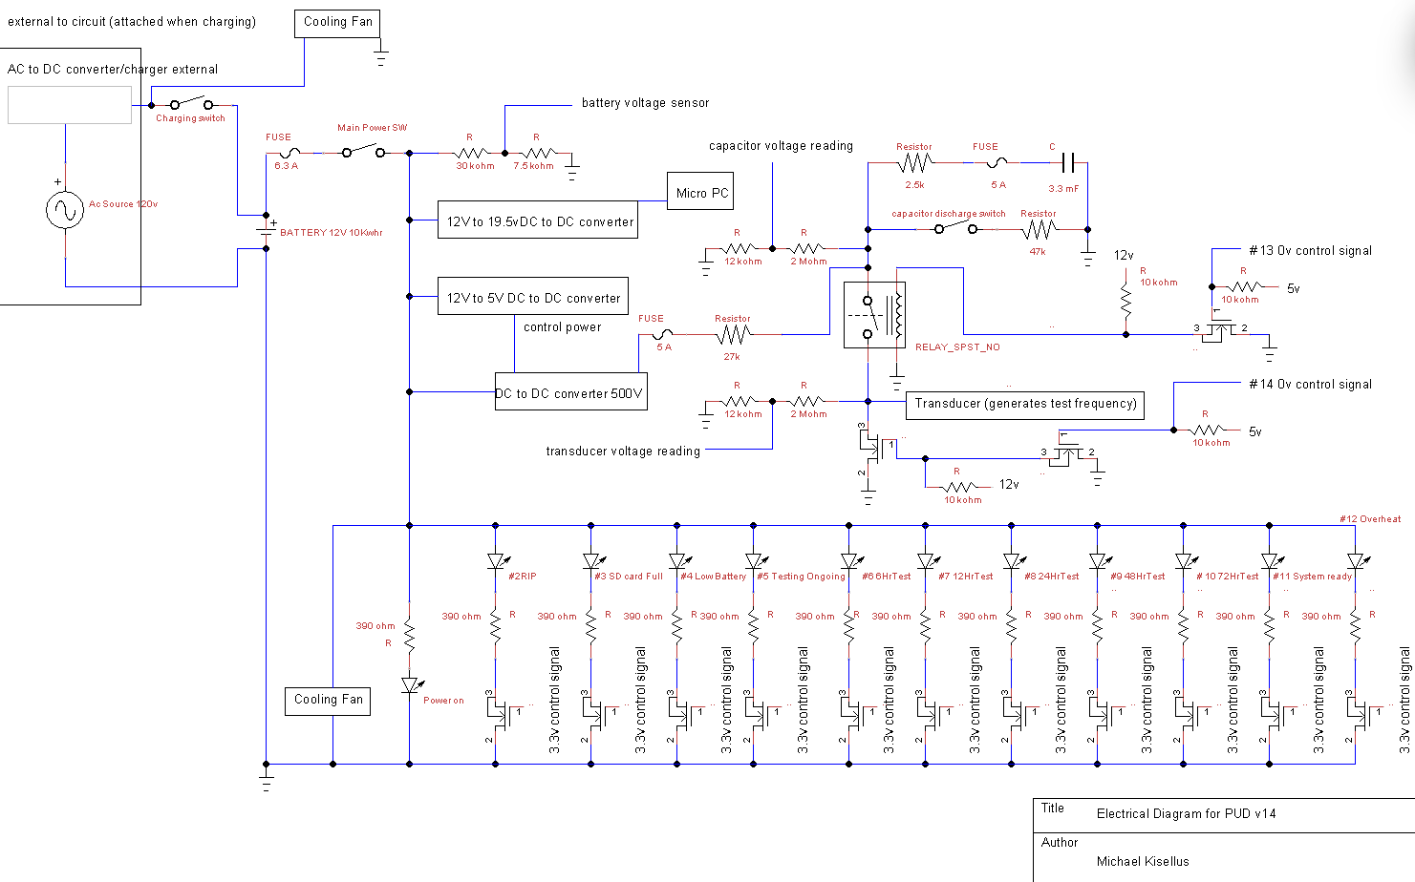
Project Overview - Work Completed
Fall ‘23:
Overall design and conceptual work.
Subsystem Progress
Electrical
Wire and construct circuits for 5V, 12V, 500V sections
Cooling
Obtain cooling fans and fan controllers
Software
Demo ADC and GPIO capabilities of Pi pico microcontroller
Demo capabilities of Thonny to control windows
Hardware
Labels created and mounted to casing
Indicating lights, switches, and exterior locks

Slide 17
Sprint 2 Backlog Status
Completed:
Electrical
Transmission (Tx) and Receiver (Rx) cables
Electrical charge testing
Electrical energization testing
Solder work for fan motor controller
Cooling
Solder and Wire EMC2101 Driver Boards
Mount fan covers
Software
[Replace with current status]
Hardware
Obtain and mount vent covers.
Remaining:
Electrical
Organize and shorten electrical wiring
Electrically connect Fan Control/Voltage divider board.
Electrically connect cooling fans
Cooling
Attach mesh to fans to prevent wiring damage.
Mount fans.
Software
[Replace with backlog]
Hardware
Seal vent covers
Route cabling.

Slide 18
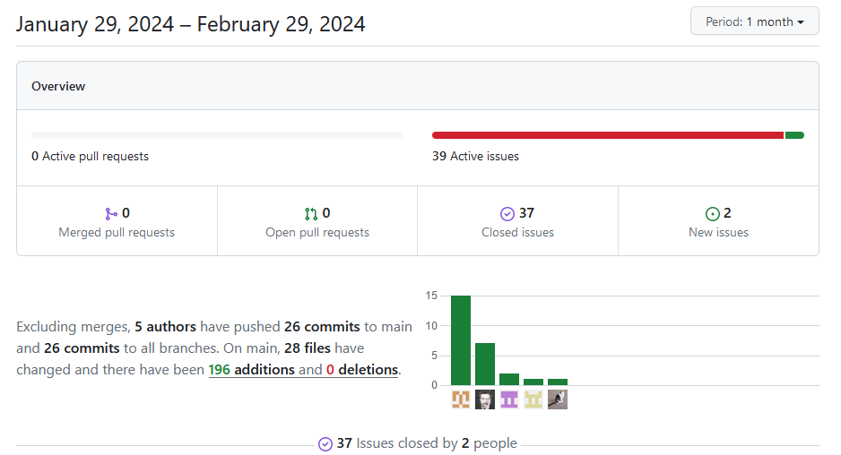
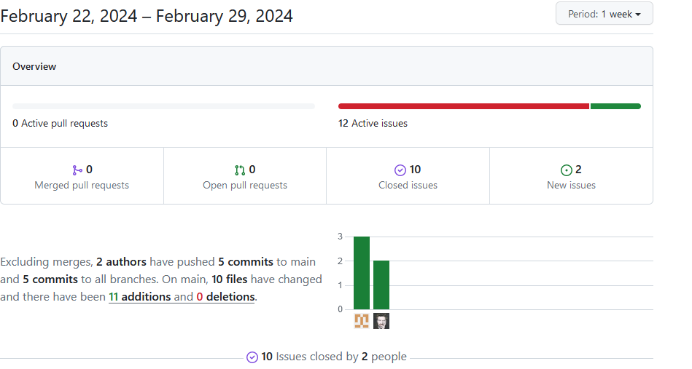
Progress for the
month and week

Slide 19
Risks and Roadblocks
Electrical shock (500v)
Electrical component failure
Internal space constraints for oscilloscope/computer
Power consumption possibly reducing operating window below 48 hr
Software reliability over 48 to 72 hr operation

Slide 20
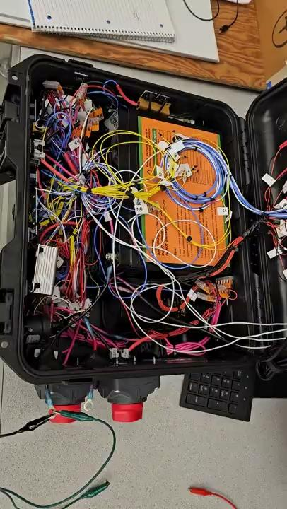
Visual Demo

Slide 21
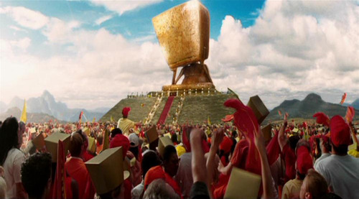

Questions?

